Slide 1
Effect of Delay on Control Systems
Leah Dickstein
Linear Estimator: Multiplicative Noise
Schenato
Gireeja Non-Coherence Estimation vs. Control
Estimation with Delay
Estimation with Delay + Packet Drops
Control with Delay
Advantages of Delay
Control with Delay + Packet Drops
Threshold for Stability
Varying Drop Probability
Connecting Drop Probability and Delay
Moving Forward

Slide 2
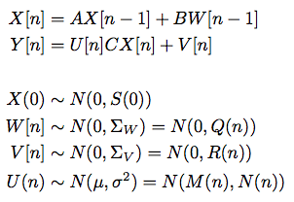
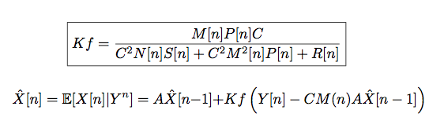
Linear Estimator: Multiplicative Noise
Problem:
Solution:
Notes:
A = 0.99, 1, 1.1, 1.5

Slide 3
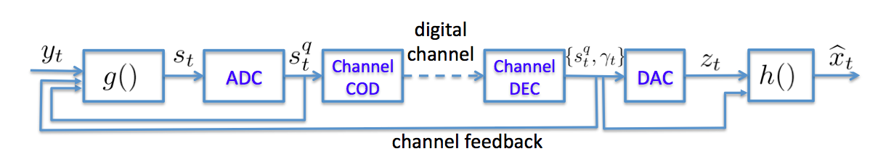
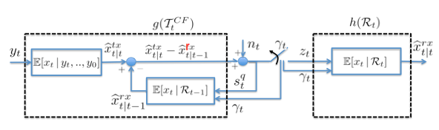


Schenato: Quant Noise + Packet Drops
Problem:
Solution:
K_{t} = p/(p+1)
Notes:
Estimation

Slide 4

Gireeja: Non-Coherence: Estimation
Notes:
Varying A curve

Slide 5

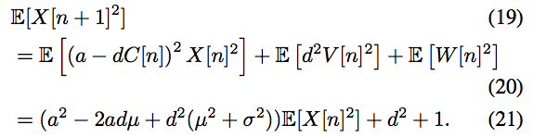


Gireeja: Non-Coherence: Control
Solution: Choose U(n) = -dY(n)

Slide 6
Estimation with Delay
X
V(n)
P
Y
C(n)
Sys
Enc
Dec
k…
Xhat

Slide 7
Estimation with Delay + Packet Drops
Notes:
Maybe redo with thicker lines

Slide 8
Control with Delay
X
V(n)
P
Y
C(n)
Sys
Enc
Dec
U(n)
k…

Slide 9
Advantages of Delay

Slide 10
Control with Delay + Packet Drops
Notes:
Threshold for Stability

Slide 11
Theoretical Curves

Slide 12
Varying Drop Probability

Slide 13
Connecting Drop Probability and Delay

Slide 14
Moving Forward

